Slide 1
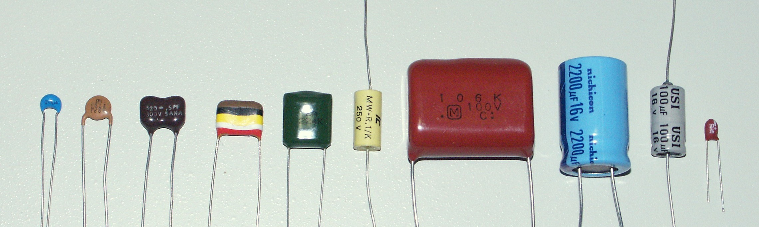
Capacitors

Slide 2
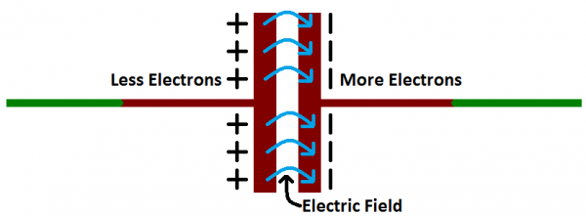
What are capacitors?
Similar to batteries (Store electrical energy)
Dif. Capacitors composed of dif. (dielectric)Materials for different functions
Capacitors storage potentional = capacitance
More capacitance = more stored charge
Measured in unit called farad
Diagram showing attraction of
+ & - electrons creating electric field between
Dielectric material

Slide 3
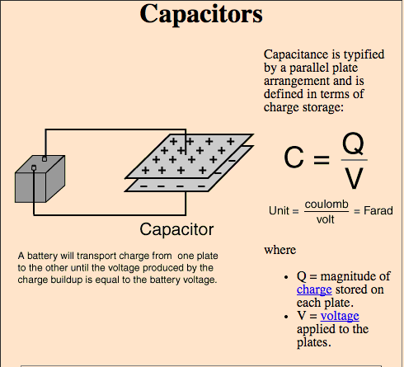
Calculating capacitors

Slide 4
How are capacitors used?
drain electricity quickly in seconds (unlike batteries)
Used camera flashes/lasers, even out DC voltage ripples,

